Slide 1

FMSV PROJECT
Group – A1
Team Members:
Divyansh Chandak 220101039
Shubhranshu Pandey 220101094
Manas Kumar Sinha 220101065
Kevin Thomas Jacob 220101054
Mayank Choudhary 220101067

Slide 2
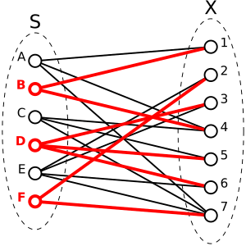
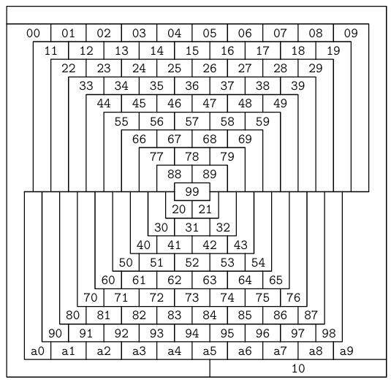
Problems for SAT solving
EXACT COVERING
Color the McGregor graph of order 10 with 4 colors, using one color at most 6 times

Slide 3
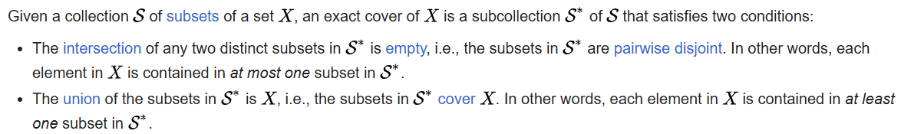
EXACT COVERING
An exact cover instance is a pair P =< V,S > ,where V is a finite set of points and S is a set of subsets of V . A solution to P is a subset S* of S such that each point v ∈ V appears in exactly one set in S* . The exact cover problem has three natural variants: decision, counting, and enumeration. The first variant asks us to determine whether a solution exists, the second variant asks us to determine the number of solutions, and the third variant asks us to explicitly construct every solution.
More Formally,

Slide 4
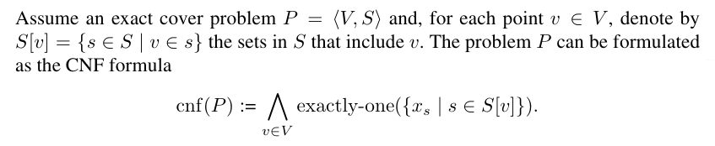
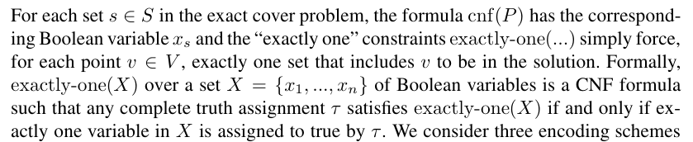
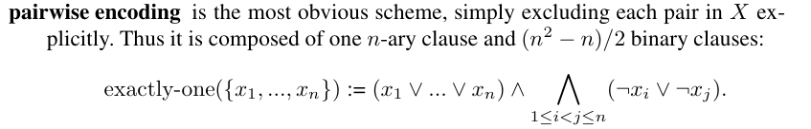
How to encode Exact Cover problem?
We used pairwise encoding to describe the given problem

Slide 5
Explanation
Next, pairwise encoding enforces that no two variables in the set can both be true. For each distinct pair (xi,xj) where i≠j , we add a binary clause: ¬xi∨¬xj. ​This clause states that if xi​ is true, then xj must be false (and vice versa), effectively limiting the set to at most one true variable.
Pairwise encoding thus consists of one n-ary clause and (n C 2) = n(n−1)/2 binary clauses. The n-ary clause enforces that at least one variable is true, and the binary clauses enforce that no two variables are true simultaneously.
This encoding directly excludes each pair of variables, keeping the formulation relatively simple and ensuring the exact cover constraint effectively.
The Goal: In an exact covering problem, we want to ensure that exactly one of a set of variables {x1,x2,…,xn} is true. This is known as a "one-hot" constraint, meaning only one variable should be true, and the others should all be false.
Pairwise encoding achieves this by first requiring that at least one variable in the set {x1,…,xn} is true. This is done with an n-ary clause: x1 ∨ x2 ∨…∨ xn. ​This clause simply ensures that at least one xi​ is true.

Slide 6
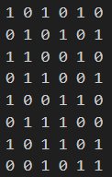
What we did?
Input matrix of subsets v/s elements
We took an input matrix of the format :
Subsets X elements
The matrix thus formed indicates the total number of subsets to be taken into account and has value of 0 or 1 corresponding to whether a particular element is present in that set or not.
a b c d e f
S1
S2
S3
S4
S5
S6
S7
S8

Slide 7
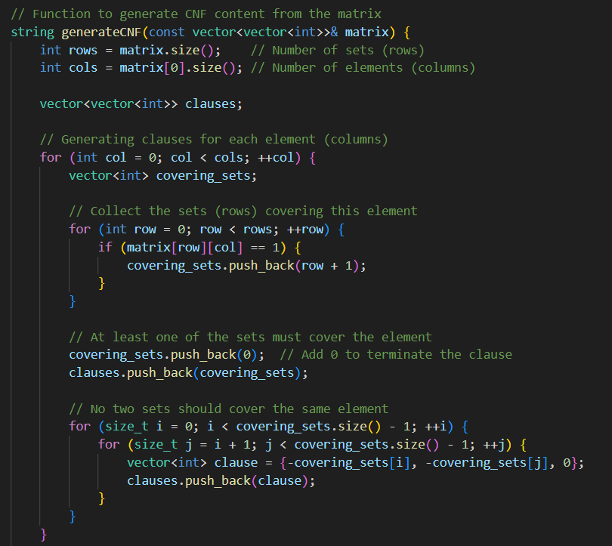
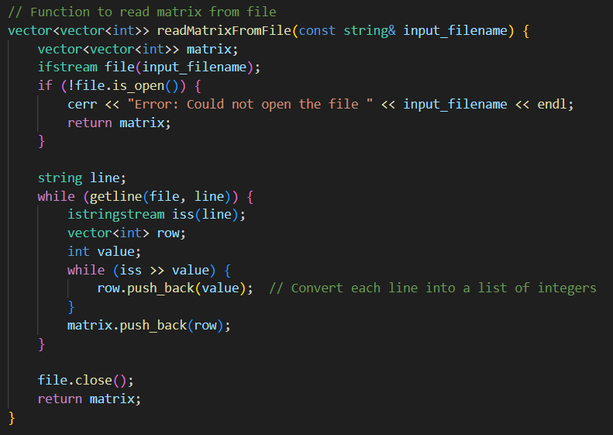

Procedure
In order to convert the given input matrix into a cnf file, we wrote a C++ code(exact_cover.cpp), which takes the input txt file and does some necessary programming to convert the matrix into DIMACS format, which could then be used to run in the CaDiCaL SAT solver.

Slide 8
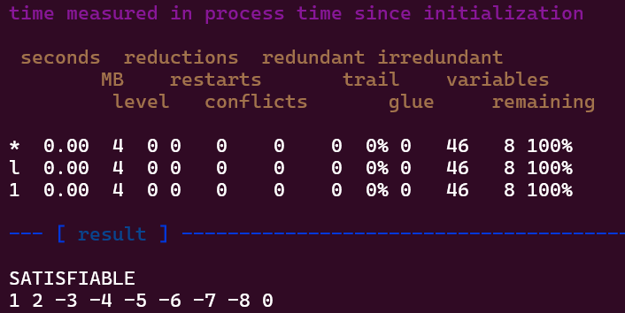
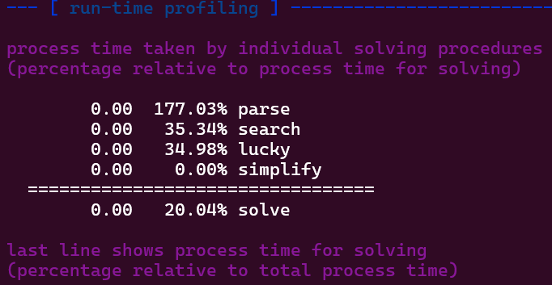
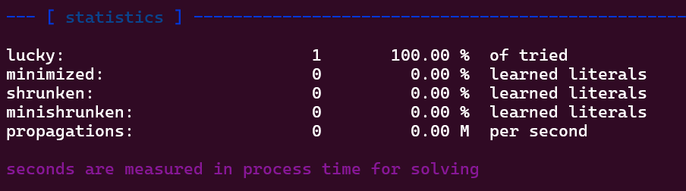
Outputs

Slide 9
Inference
From the output observed we can get to know a lot of things,
Firstly, for the given input matrix of subsets and elements, the Exact covering problem is satisfiable. The values 1 2 -3 -4 -5 -6 -7 -8 0, indicate that the ssubsets to be taken for the cover are S1 and S2. –ve sign means that the corresponding value of the variable is 0 or the subset should not be taken in the cover.
The table in the middle of the output shows various statistics as the solver progresses through solving.
reductions: Tracks simplification steps (e.g., removing redundant clauses).
redundant and irredundant: Count redundant and irredundant clauses in the formula.
trail: Number of literals on the current decision trail.
variables: Number of variables in the SAT problem.
conflicts: Count of conflicts encountered during solving.
glue: Refers to the "glue level," which measures the quality of learned clauses.
Each row updates these values over the time steps taken by the solver. The final row shows these values as they reach a solution.

Slide 10
Profiling and Performance Metrics:
parse: Time spent parsing the input CNF file.
search: Time spent in the search phase for finding solutions.
lucky: Refers to optimizations where the solver quickly finds an assignment that satisfies a large portion of constraints.
simplify: Time spent simplifying the formula by removing clauses or literals.
Each percentage shows the time proportion relative to the total solving time. For example, 177.03% in parse suggests the process used more computational focus here due to optimizations.
Statistics and Resources:
lucky: 100% of the clauses or decisions benefited from the "lucky" optimization.
propagations: Tracks the rate of variable assignments per second.
resident set size: Memory allocated by the solver, showing efficient usage with 3.98 MB.
Shut Down: Finally, the solver reports a clean shutdown, showing the total process time (0.00 seconds) and real time (0.01 seconds) it took to reach the solution.
In summary, the solver confirms that it found a solution (satisfiable assignment), provides the values of variables in this solution, and offers profiling details showing an efficient solve with minimal memory usage and time. This output indicates that the exact cover problem was solved effectively, leveraging various optimization techniques to reach a quick solution.

Slide 11
McGREGOR GRAPH
In the April, 1975 issue of Scientific American, Martin Gardner, in his column “Mathematical Games” published a list of what he claimed were 6 major mathematical discoveries of 1974 that “for one reason or another were inadequately reported to both the scientific community and the public at large.” One was a planar, 110-node graph, attributed to William McGregor of Wappingers Falls, New York, that he asserted could not be colored with less than 5 colors, thereby disproving the as-yet unproven conjecture that 4 colors were sufficient to color any planar graph.
But this was a joke for April’s fool and eventually it continued to stay that the same 110-region graph could be colored with 4 colors.
In our problem, we have to encode a SAT problem which states to draw a McGregor graph of order 10 which could be color with atmost 4 colors, out of which one color should be only atmost 6 times.

Slide 12
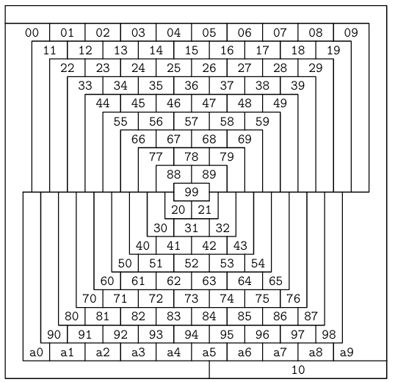
In a McGregor graph, we have 110 nodes and each node is represented by a block of region. All the blocks whose sides touch with one another are said to be adjacent and there exists an edge between the two nodes.
The nodes are labelled in hexadecimal.
Now in order to encode the given problem, we again followed the same process. Found the constraints, formulated the clauses and wrote a program to generate the cnf file for the corresponding problem.

Slide 13
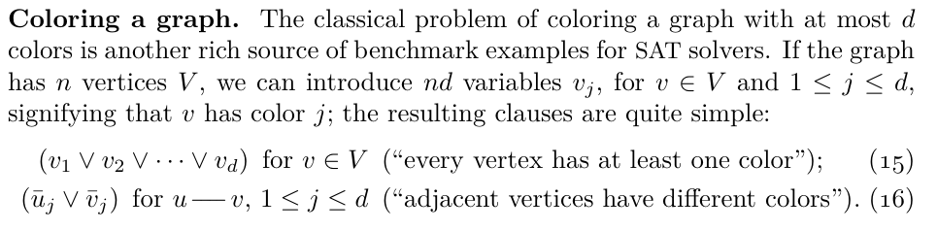


How to encode the constrained McGregor Graph?

Slide 14
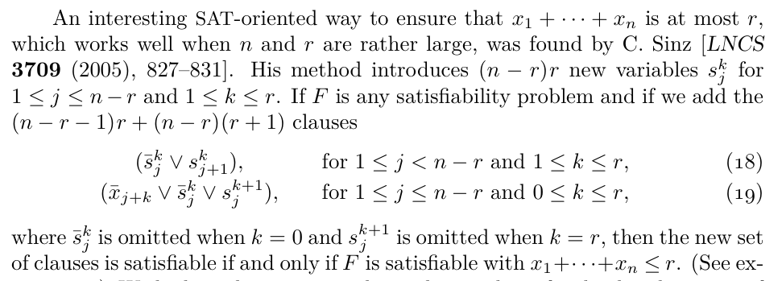
Now, in order to add our specific constraint that there should be one color which is not used more than 6 times, we need to take help of an already derived result by C. Sinz. He wrote a paper which has a way to ensure the given constraint.

Slide 15
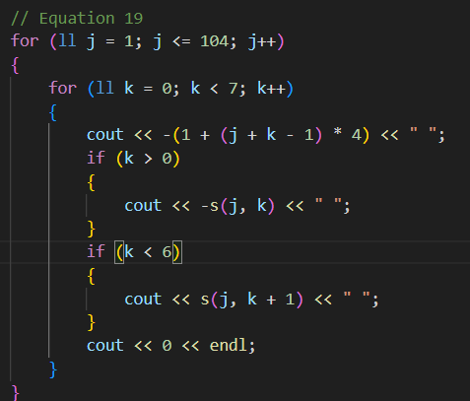
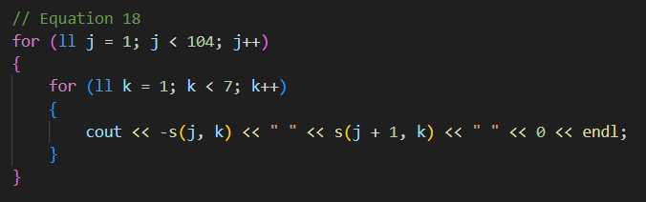
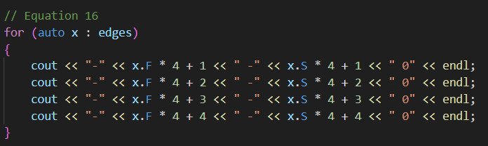
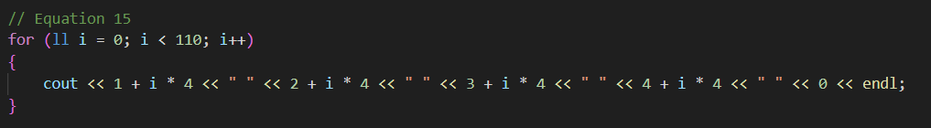
What we did?
We wrote a C++ code to generate the necessary CNF file for the problem to be run on the CaDiCaL solver. The code consists of loops to generate constraints for each of the constraint clauses. We also precalculated the edges for easy calculations.

Slide 16
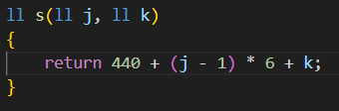
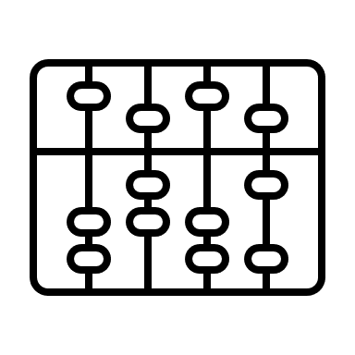
The new variable introduced by C.Sinz is taken into account by assigning a different number to each of the s(j,k) counting from 441.
Each variable till 440 basically denotes the color of each of the 110 regions. Let’s divide 440 variables into 110 groups of 4 variables each. Now the color of a region is decided by the only label number out of these 4, which after running the SAT solver would remain positive.
Eg: If the result shows that in order for the problem to be satisfiable, 1st region must have label numbers like -1 2 -3 -4. This means that 1st region is colored which 2nd color and neither of the remaining ones.

Slide 17
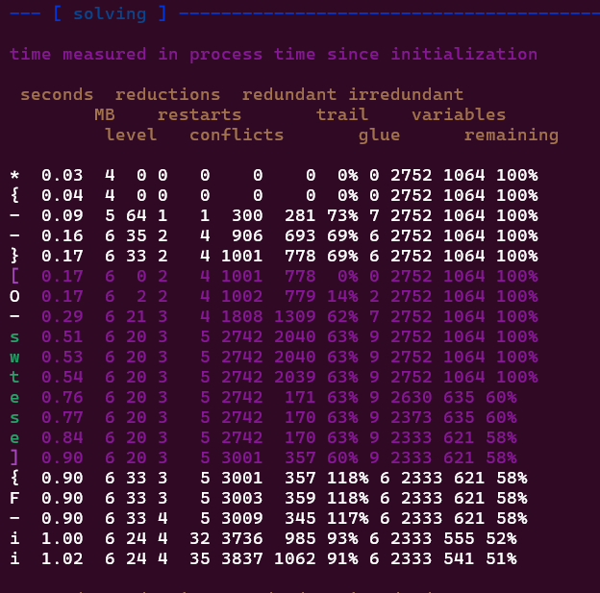
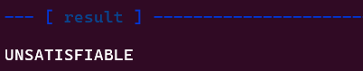
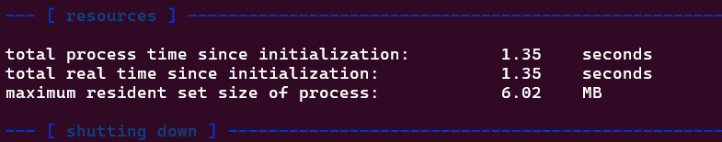
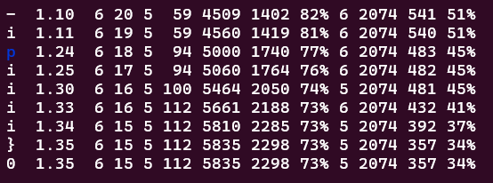
Outputs
The CNF file thus generated will have 1064 variables and 2752 clauses.
On running this file in the CaDiCaL solver, we get the following results.
The given problem is UNSATISFIABLE.

Slide 18

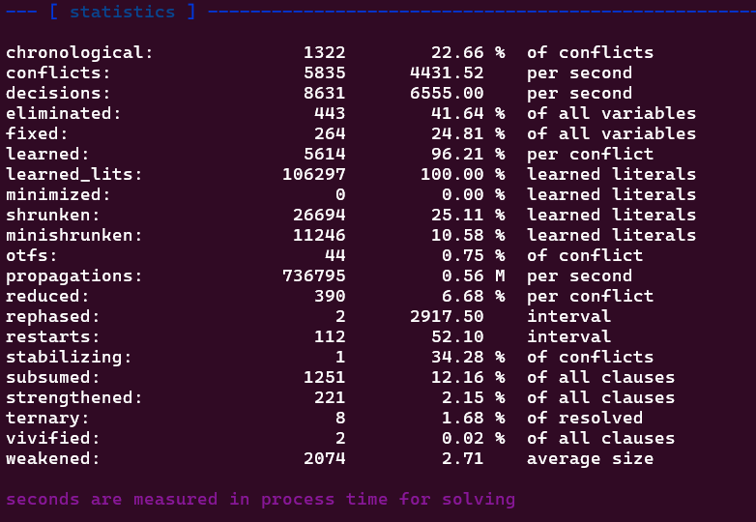
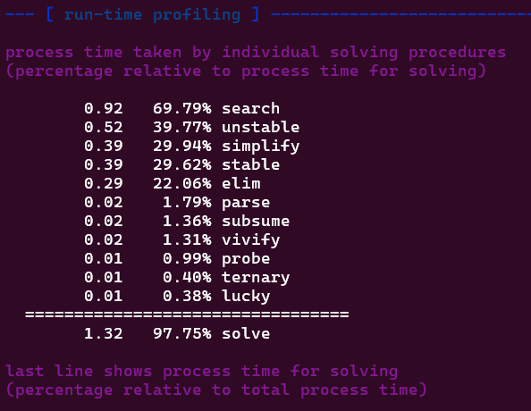

Slide 19
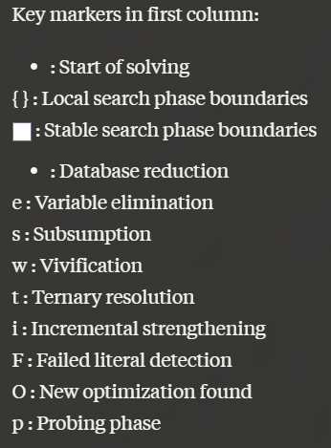
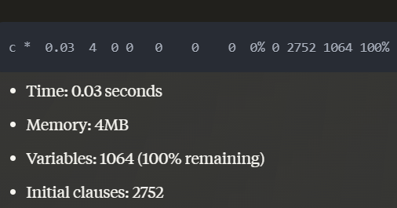
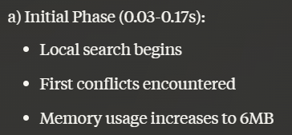
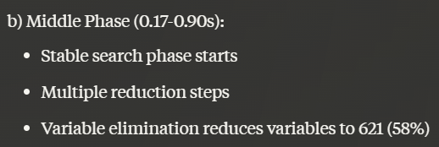
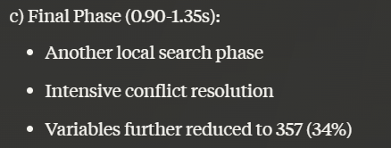
Inference
SOLVING PROGRESS SECTION: Each line shows the solver's state at different points, with columns representing:
seconds MB level restarts conflicts redundant glue% depth trail variables remaining%
INITIAL STATE:
SOLVING PHASES: The solver goes through multiple phases:

Slide 20
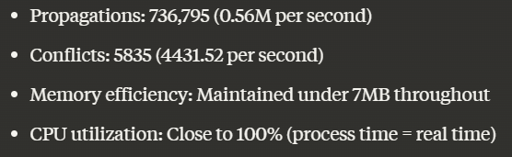
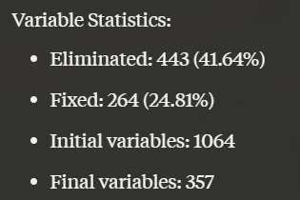
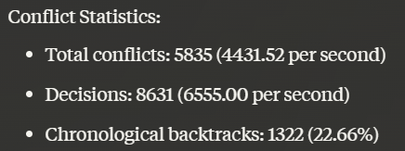
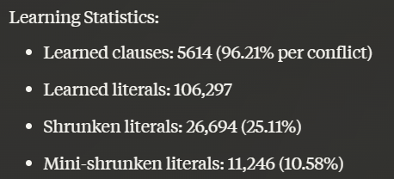
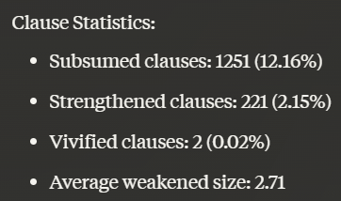
Runtime Profiling: Shows time spent in different solving procedures.
0.92 69.79% search
0.52 39.77% unstable
0.39 29.94% simplify
0.39 29.62% stable
DETAILED STATISTICS:
Performance Metrics:
This output shows a thorough search process that systematically proved the impossibility of finding a valid coloring under the given constraints, using various solving techniques like variable elimination, clause learning, and multiple search strategies.

Slide 21
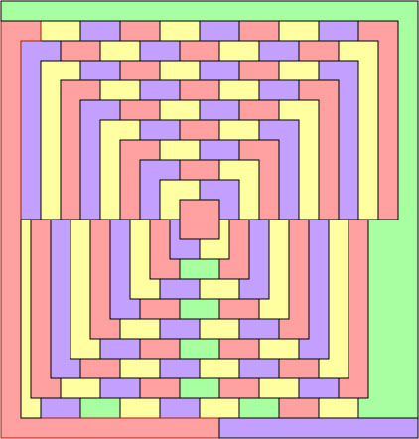
When will it turn optimal?
If instead of the constraint that one color should be used atmost 6 times, we change it to 7 times then we can have a satisfiable solution to the problem.
We get a coloring with just 7 green nodes, 34 blue and red ones, and 35 yellow.
This solution has unique properties:
It is the only coloring where one color is used at most 7 times.
It is the only coloring where one color is used at least 35 times.

Slide 22
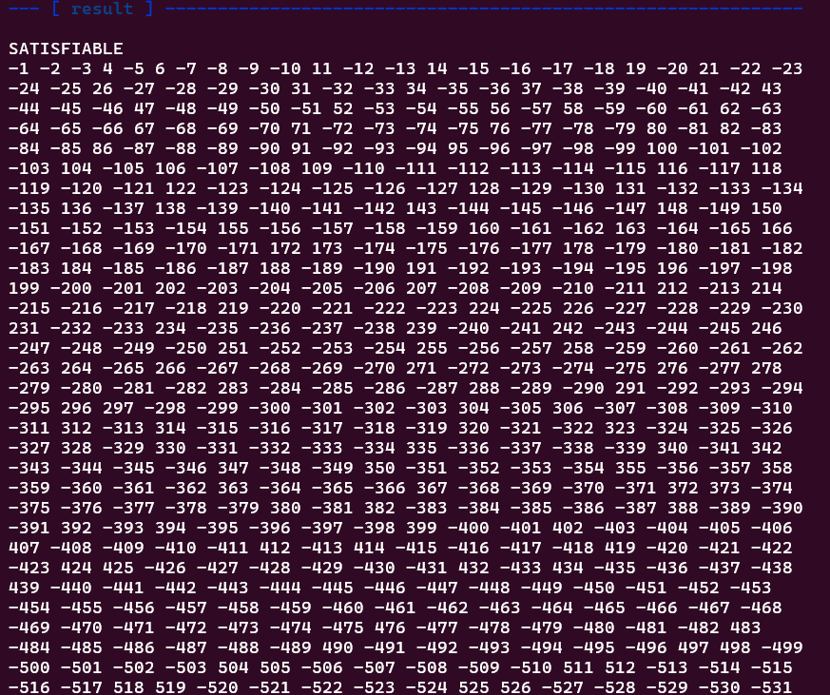
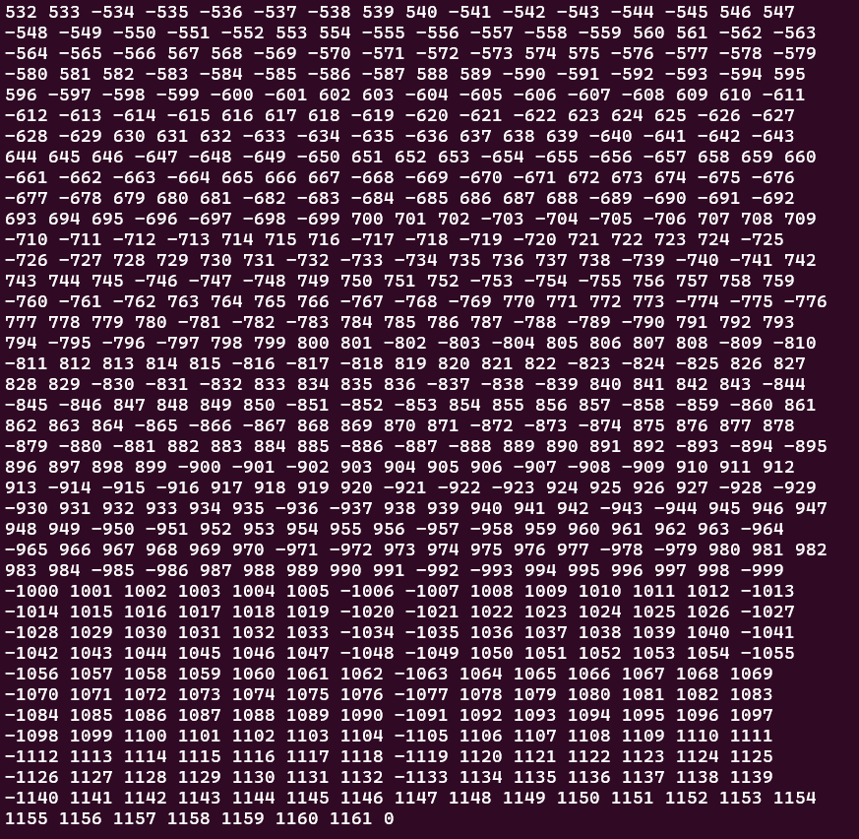

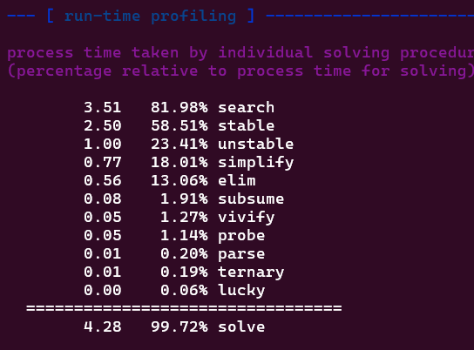
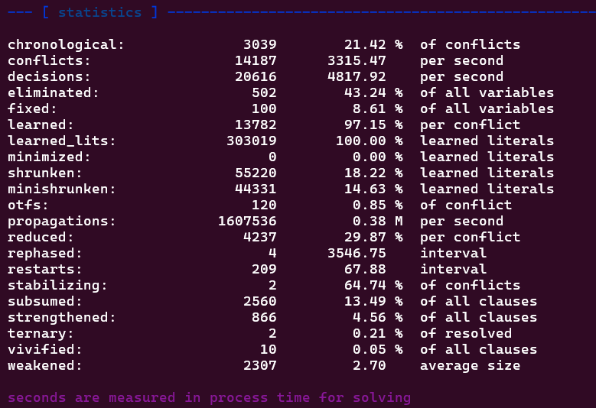
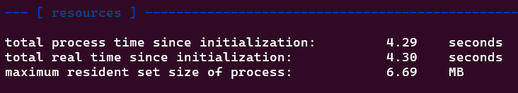
We can simulate the same by making necessary changes in the CNF generator file for McGregor.cnf.
After running the CNF file on the CaDiCaL solver we get a satisfiable solution with variable assignment as follows:

Slide 23
Bonus Task
Analyzing SAT Solver Performance: Impact of Restart Intervals
In this experimentation, I investigate the performance impact of different restart interval settings in the CaDiCaL SAT solver. Restarts are a crucial component of modern SAT solvers that help escape from local search spaces and potentially find solutions more quickly. The restart interval parameter controls how frequently the solver performs these restarts.
I benchmark the solver's performance using various restart intervals (100, 200, 300, 400, and 500) on a collection of CNF instances. The experimental setup involves:
A bash script to automate solver runs with different restart intervals
Processing the solver outputs to extract timing information
Generating a cactus plot to visualize the performance differences
Analyzing the cumulative solving times across different restart settings

Slide 24
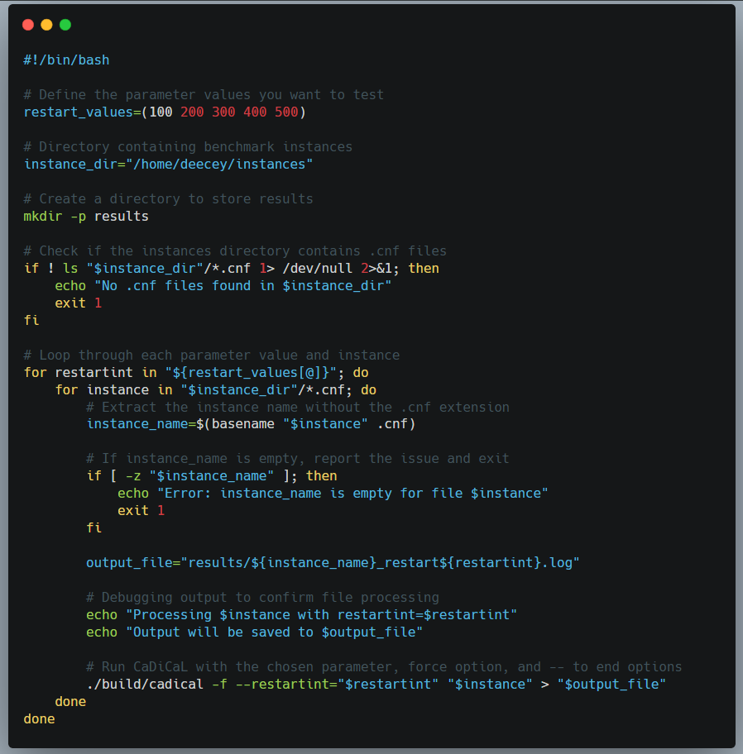
Here's a explanation of the bash script:
The bash script automates testing of the CaDiCaL SAT solver with different restart interval settings:
1. Sets up test parameters:
2. Creates nested loops to:
- Iterate through each restart interval
- Process each .cnf file in the instances directory
3. For each combination:
- Creates unique output filename
- Runs CaDiCaL with specified restart interval
- Saves output to log file:
The script systematically tests all CNF instances with each restart interval value, storing results in separate log files for later analysis.

Slide 25
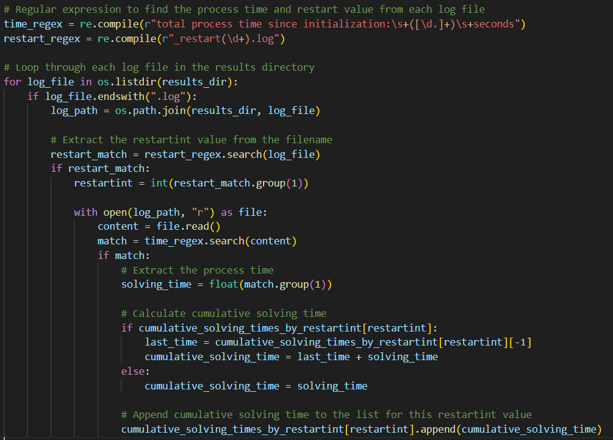
The output is a cactus plot showing:
- X-axis: Number of solved instances
- Y-axis: Cumulative solving time
- Different lines for each restart interval
- Helps visualize which restart interval performs best across all instances
The Python script creates a cactus plot from SAT solver results:
1. Data Collection:
2. Processing:
- Reads each log file
- Extracts restart interval from filename
- Gets solving time using regex
- Calculates cumulative times for each restart value
3. Plotting:
plt.figure(figsize=(10, 6))
for restartint, cumulative_solving_times in sorted(cumulative_solving_times_by_restartint.items()):
plt.plot(range(1, len(cumulative_solving_times) + 1),
cumulative_solving_times,
marker='o',
linestyle='-',
label=f"restartint={restartint}")

Slide 26
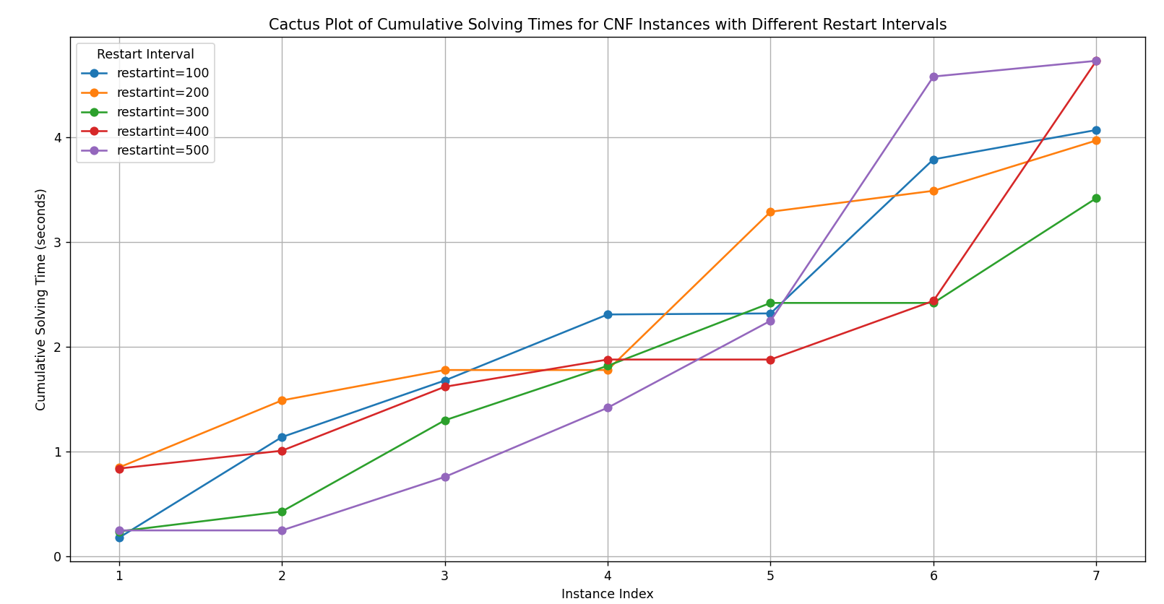

Slide 27
Observations
Lower restartint values generally lead to more consistent and gradually increasing cumulative solving times. This suggests that frequent restarts may provide steadier progress through the instances, though at a slower cumulative time increase.
Higher restartint values show a steeper rise in cumulative time for some instances, which might indicate that less frequent restarts could lead to higher solving times for challenging instances. However, it may perform better on easier instances, as seen by its lower initial cumulative time.
The performance variation seen here may reflect the balance between exploration and exploitation in the solver's strategy. Frequent restarts might help avoid getting stuck in difficult parts of the search space, while infrequent restarts might allow for a deeper exploration that sometimes pays off but may also result in longer solving times on harder instances.

Slide 28
Bibliography/ Files
https://en.wikipedia.org/wiki/Exact_cover
Necessary files and codes: Deecey01/FMSV_Project
The Art of Computer Programming, Volume 4, Fascicle 6 Satisfiability (Donald E. Knuth)
https://www.cs.cmu.edu/~bryant/boolean/macgregor.html
Exact Cover via Satisfiability: An Empirical Study (An abstract by Tommi Junttila, and Petteri Kaski)

Slide 29
Thank You

